Slide 1
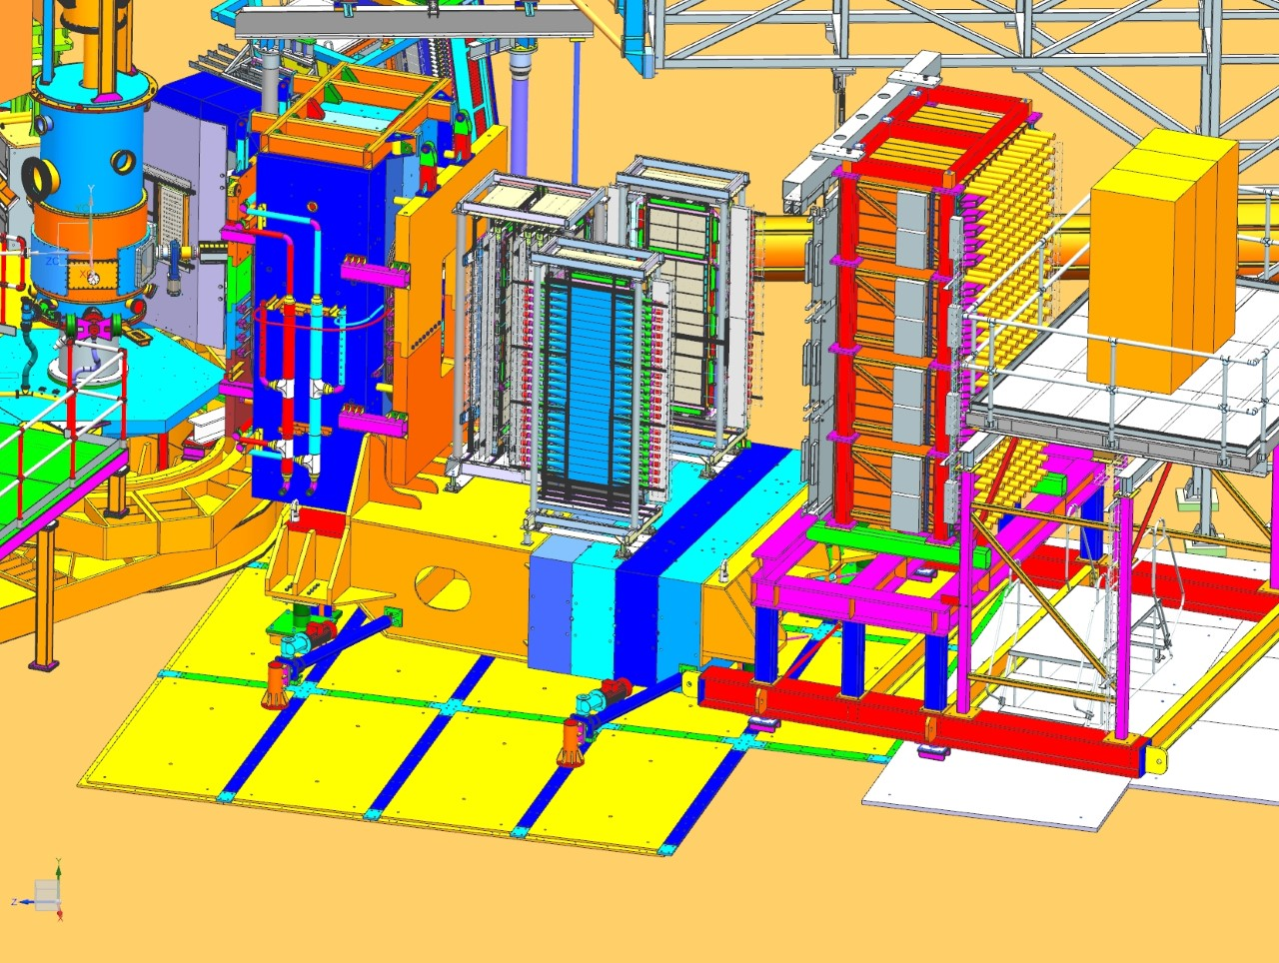
CDET shown in white and gray on HCAL support if ready for Gen-RP

Slide 2
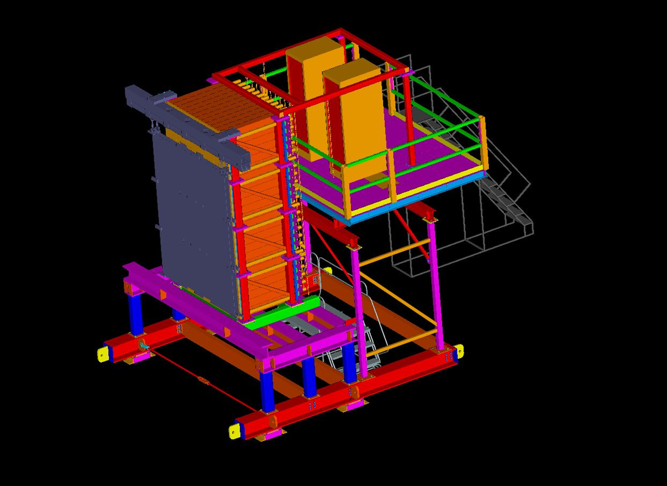
CDET placed on HCAL support, if used for Gen-RP, GMn or GEn

Slide 3
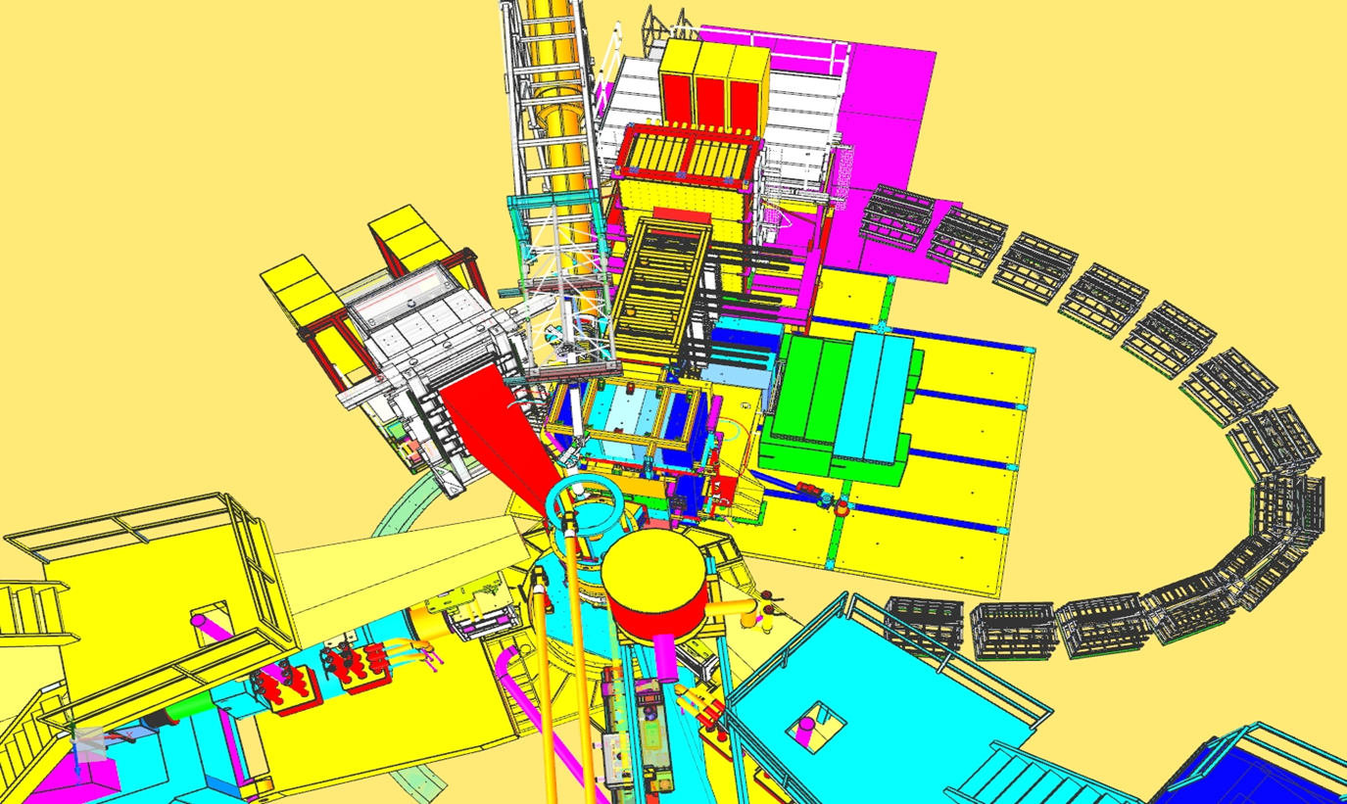
For GEp, CDET sits on floor with support attached to ECAL support frame to stabilize it. Derek has a more current model of this.

Slide 4
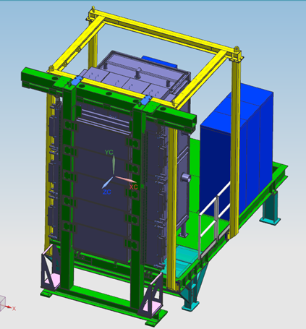
This is more recent image from Derek’s model with CDET attached to ECAL for GEp.

